Slide 1
Section 2.4
Circles
Copyright © 2012 Pearson Education, Inc. Publishing as Prentice Hall.

Slide 2
Copyright © 2012 Pearson Education, Inc. Publishing as Prentice Hall.

Slide 3
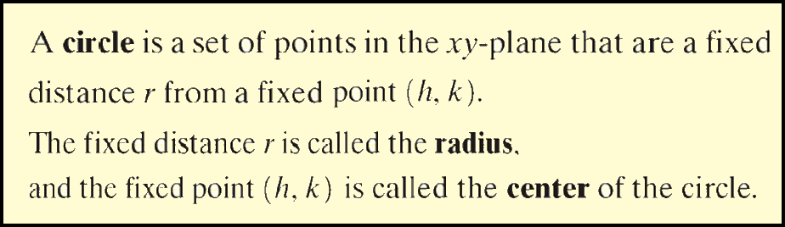
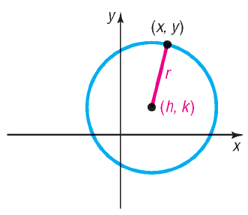
Copyright © 2012 Pearson Education, Inc. Publishing as Prentice Hall.

Slide 4
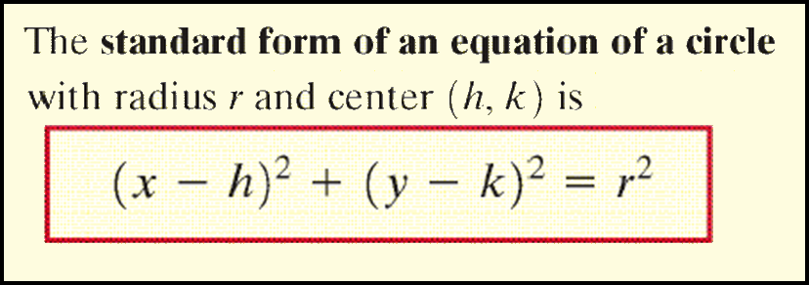
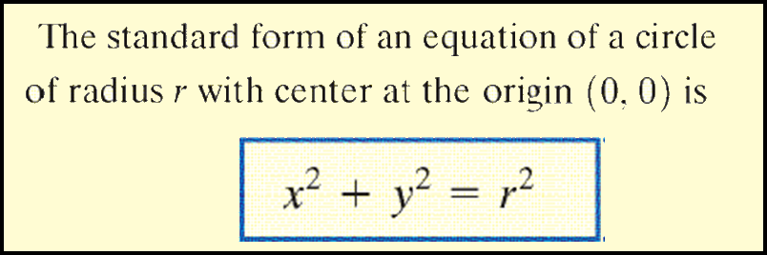
Copyright © 2012 Pearson Education, Inc. Publishing as Prentice Hall.

Slide 5
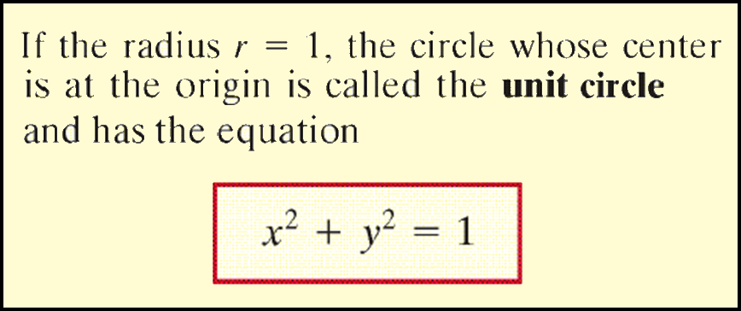
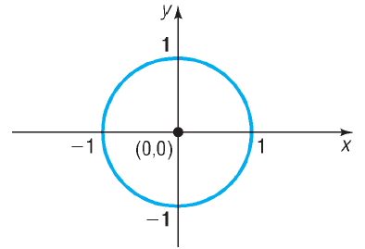
Copyright © 2012 Pearson Education, Inc. Publishing as Prentice Hall.

Slide 6


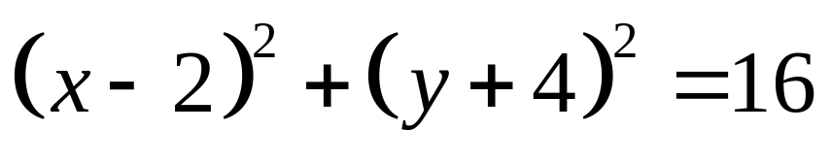
Write the standard form of the equation of the circle with radius 4 and center (2, – 4).
Copyright © 2012 Pearson Education, Inc. Publishing as Prentice Hall.

Slide 7

Copyright © 2012 Pearson Education, Inc. Publishing as Prentice Hall.

Slide 8

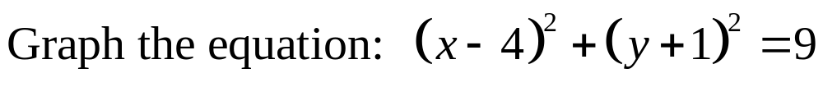
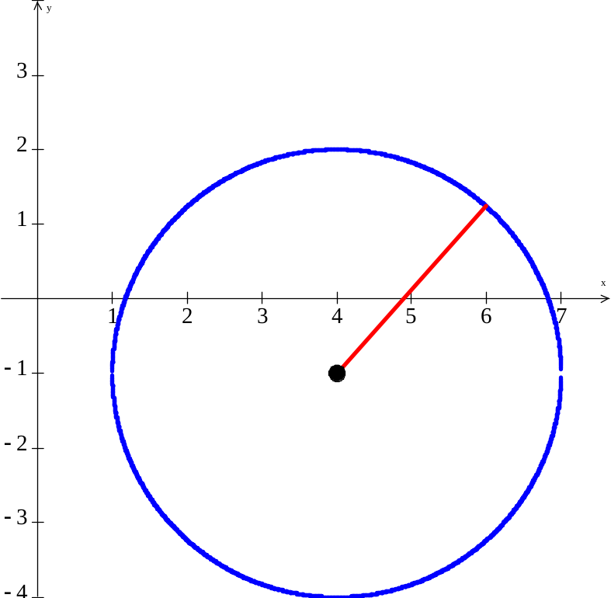
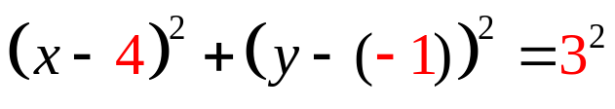
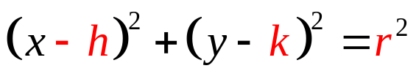
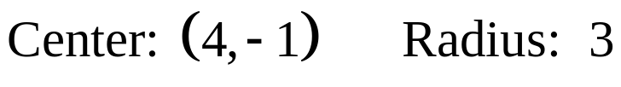

Copyright © 2012 Pearson Education, Inc. Publishing as Prentice Hall.

Slide 9
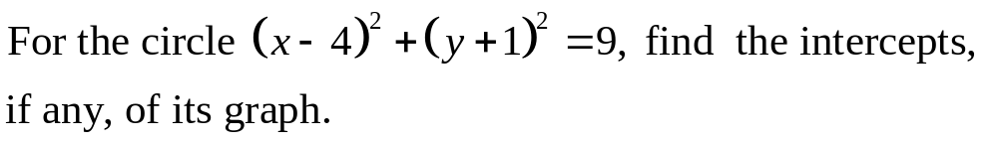
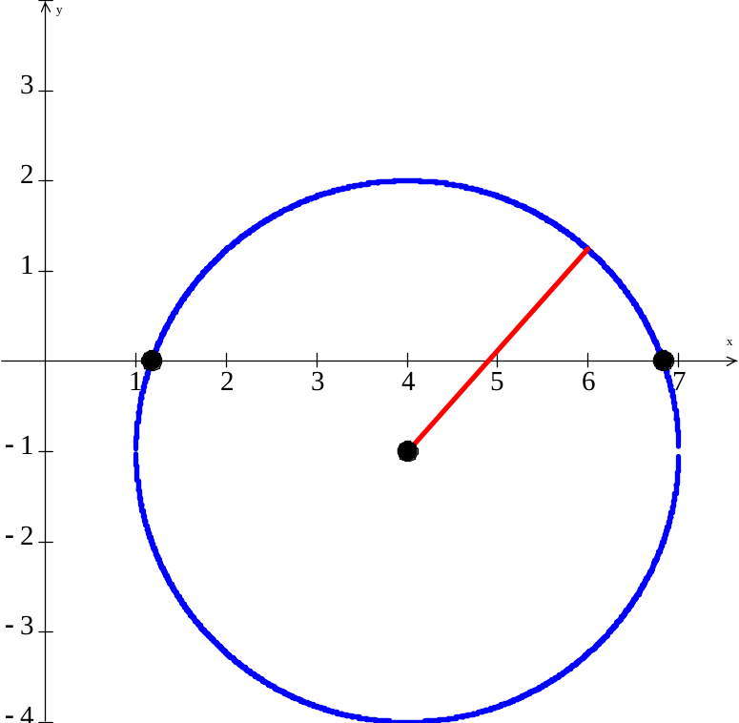
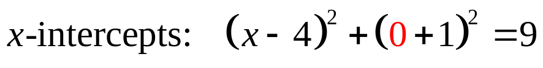


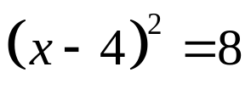



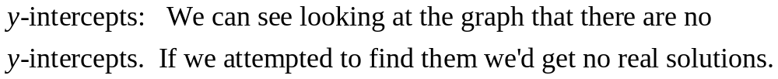
Copyright © 2012 Pearson Education, Inc. Publishing as Prentice Hall.

Slide 10
Copyright © 2012 Pearson Education, Inc. Publishing as Prentice Hall.

Slide 11

Copyright © 2012 Pearson Education, Inc. Publishing as Prentice Hall.

Slide 12
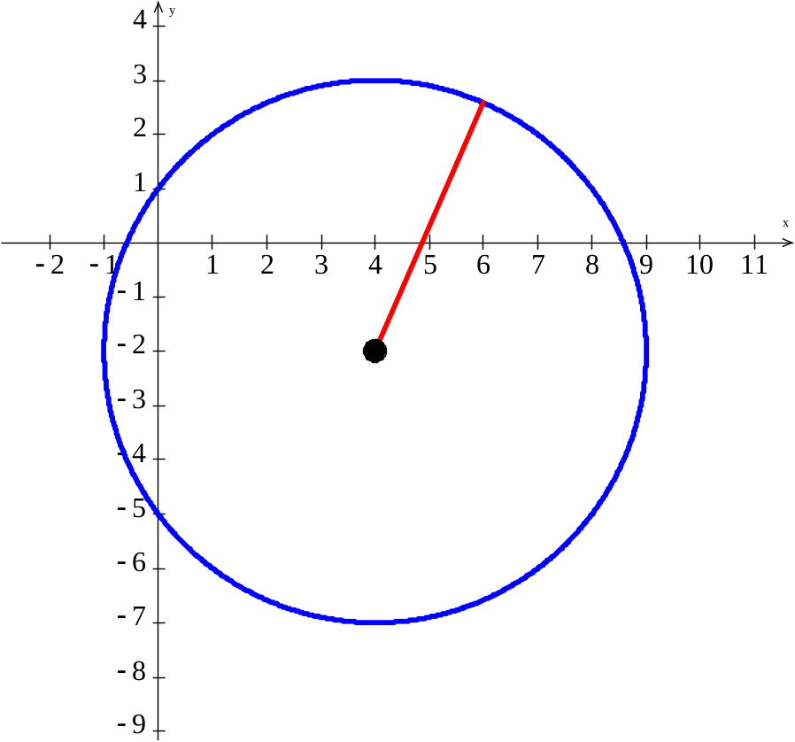

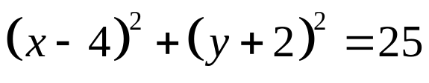
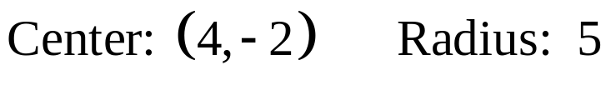

Copyright © 2012 Pearson Education, Inc. Publishing as Prentice Hall.

Slide 13
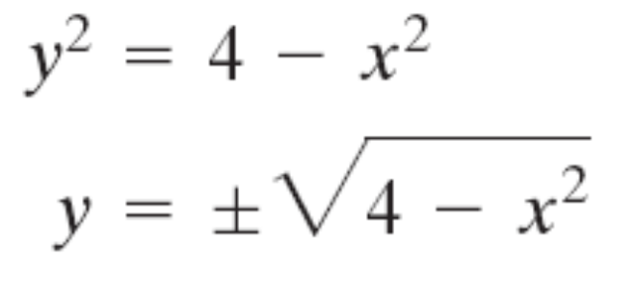
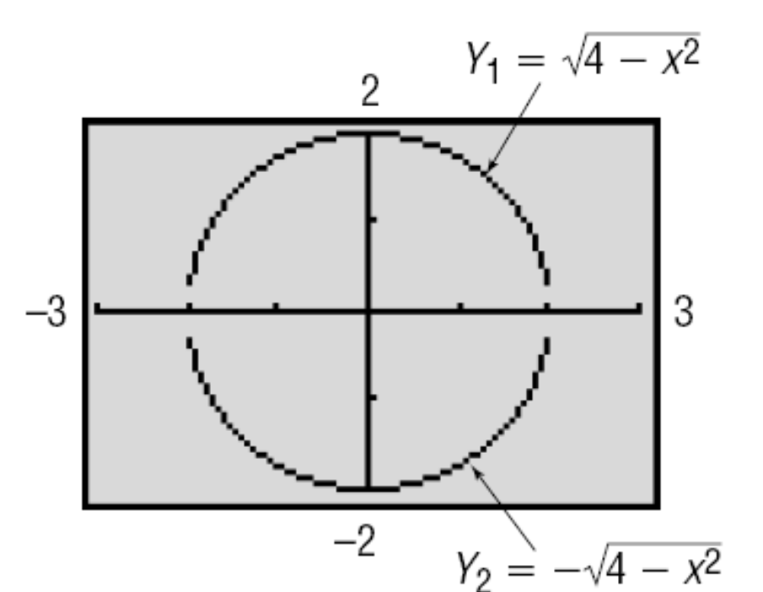
Copyright © 2012 Pearson Education, Inc. Publishing as Prentice Hall.

